Slide 1
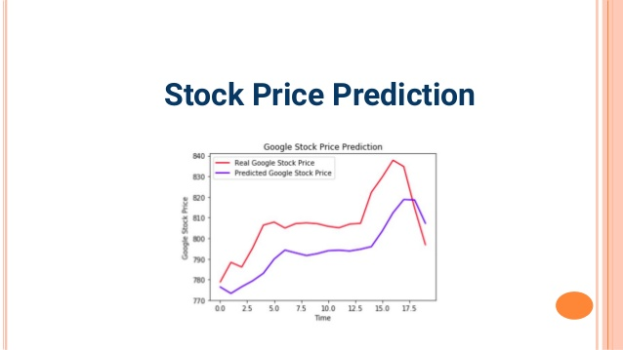

Slide 2
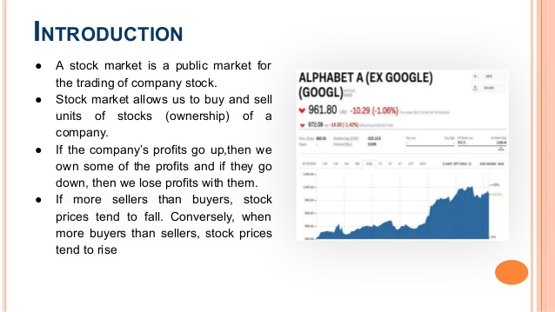

Slide 3
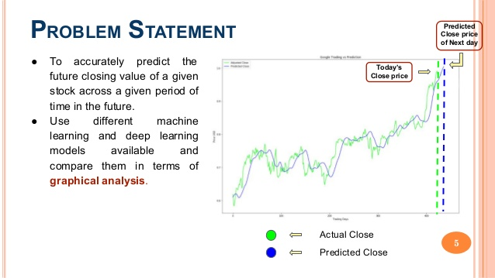

Slide 4
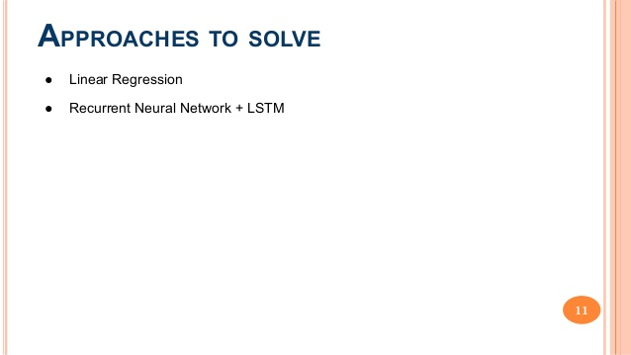

Slide 5
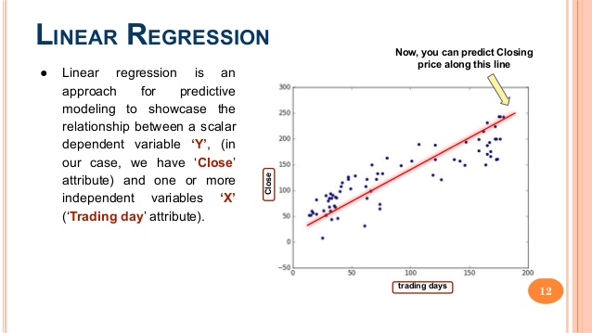

Slide 6
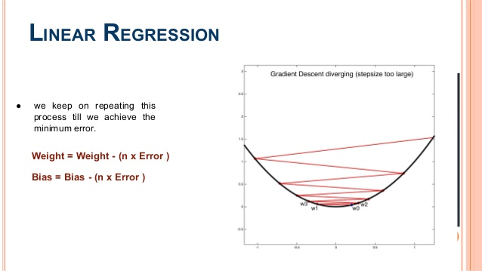

Slide 7
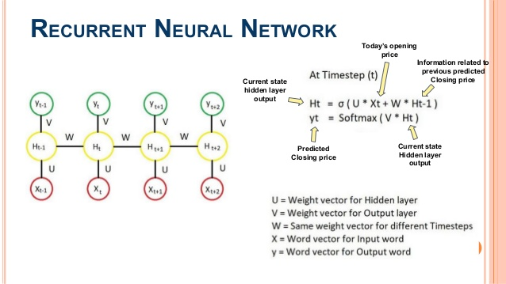

Slide 8
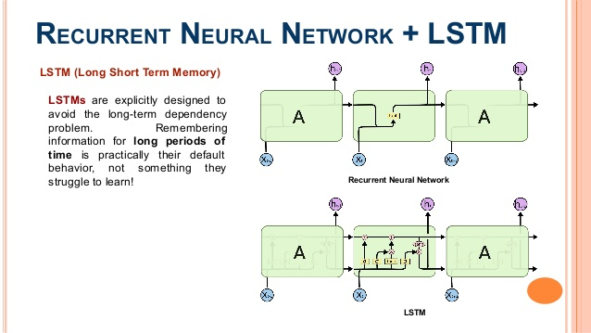

Slide 9
Discussion and evaluation
Most common techniques used in the forecasting of financial time series are Support Vector Machine (SVM), Support Vector Regression (SVR) and Back Propagation Neural Network (BPNN). In this article, we use neural networks based on three different learning algorithms, i.e., Levenberg-Marquardt, Scaled Conjugate Gradient and Bayesian Regularization for stock market prediction based on tick data as well as 15-min data of an Indian company and their results compared.

Slide 10
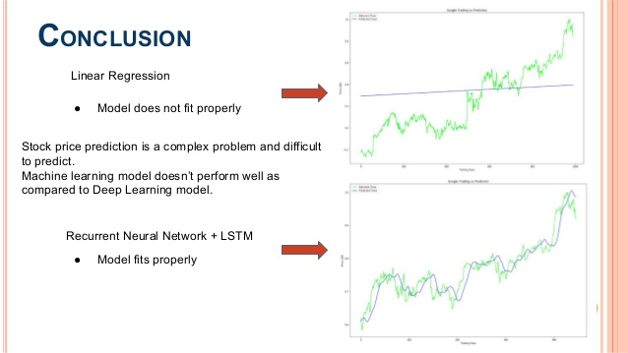
The mentioned three algorithms provide an accuracy of 99.9% using tick data. The accuracy over 15-min dataset drops to 96.2%, 97.0% and 98.9% for LM, SCG and Bayesian Regularization respectively which is significantly poor in comparison with that of results obtained using tick data.

